Slide 2
Problem-1
Consider a non-persistent CSMA system. Assume that the average length of the busy period is 10 ms while the average length of the idle period is 10 ms. The packet length is 20 KB, the data rate of the channel is 15 Mbps. The offered load is 1 and the vulnerable period is 0.5s. What is the utilization of the CSMA system?

Slide 3
Solution
Throughput = U / (B + I)
B (Busy period) : 10ms
I (Idle period) : 10ms
U = T * (e ^(-gt))
T = packet size / Bit rate = 20Kb/15Mbps = 10.6 ms
G = 1
t = 0.5 second
e ^(-gt) = 0.6065
U = 10.6 ms * 0.6065 = 6.4289 ms
Throughput = U / (B+I) = 6.4289 ms / 20 ms = 0.32

Slide 4
Problem-2
Consider a non-persistent CSMA system. Assume the offered load is 0.6 and the packet size is 20KB.
The rate at which data is being transmitted is 15Mbps. The packet travels through the network over the distance of 1Km and the propagation speed is 2 * 10^6 m/s. Calculate the utilization of the CSMA system?
[ HINT: Recall the formula of calculating throughput in non persistent CSMA system]

Slide 5

Solution:
Given:
Offered load (g) = 0.6
Packet size = 20KB
Bit rate = 15 Mbps
Distance = 1Km
Propagation speed = 2 * 10^6 m/s
a = t / T ( t is propagation delay and T is transmission delay)
Ans : 0.6414

Slide 6
Problem-3
Lets define G as the product of offered load and Transmission delay.
G = gT
How throughput will change according to different values of G.
[ HINT: Recall the graph between Throughput and offered Load]

Slide 7
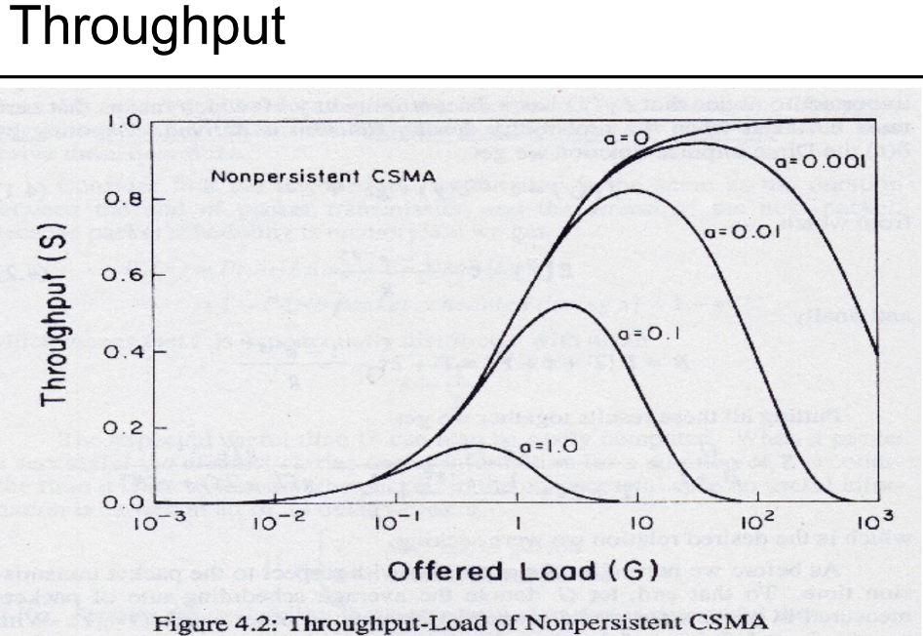
Solution
As the packet size increases, throughput will also increase

Slide 8
Problem-4
Identify and explain the different types of interframe spaces used in IEEE 802.11 standards (e.g., SIFS, PIFS, DIFS). How does each type influence frame transmission priority?
[HINT: Recall IFS and Frame Priority concept].

Slide 9
Solution
There are several types of interframe spaces utilized in IEEE 802.11, including Short Interframe Space (SIFS), Distributed Interframe Space (DIFS), and Point Coordinated Interframe Space (PIFS). Each type serves a specific purpose and provides different levels of priority for frame transmission. SIFS typically allows for the highest priority data transmissions, while DIFS and PIFS are used for lower-priority frames.

Slide 10
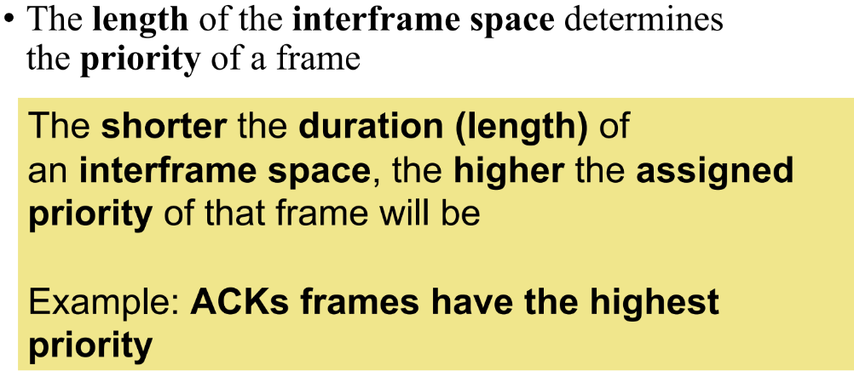
Solution:
SIFS: Shortest duration
PIFS: Second shortest duration
DIFS: Normal duration
Priority Order: SIFS > PIFS > DIFS

Slide 11
Problem-5
Assume the stations A,B,C,D,E and F use CSMA for their data transmission. The position and the range of each station are shown below. List down the hidden nodes for the following transmission:
F -> A
A -> B
B -> C
C -> D
Figure is on the next slide:

Slide 12
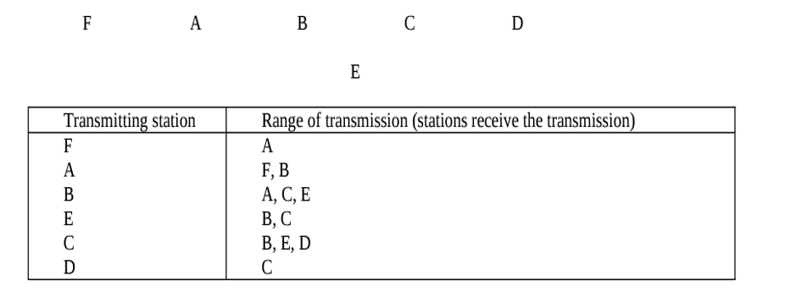
Problem-5

Slide 13
Solution
F -> A
{B}
A -> B
{C,E}
B -> C
{D}
C -> D
{}

